Slide 1
Transient & Steady State Response Analysis

Slide 2
Previous Class
In
  Intro to Laplace
  Block diagram reduction
  Signal flow graphs (SFGs)
Transfer Function

Slide 3
Today’s class
Transient & Steady State Response Analysis
  First Order System
  Second Order System

Slide 4
Learning Outcomes
At the end of this lecture, students should be able to:
  Identify between transient response & steady state response
  Obtain the transfer function for a first order system based on graph analysis
  To become familiar with the wide range of response for second order systems

Slide 5
In Chapter
What you are expected to learn :
First order system
Routh-Hurwitz Criterion
Chapter
Steady-state error
Second order system

Slide 6
Introduction
The time response of a control system consists of two parts:
Transient response
- from initial state to the final state – purpose of control systems is to provide a desired response.
2. Steady-state response
- the manner in which the system output behaves as t approaches infinity – the error after the transient response has decayed, leaving only the continuous response.

Slide 7
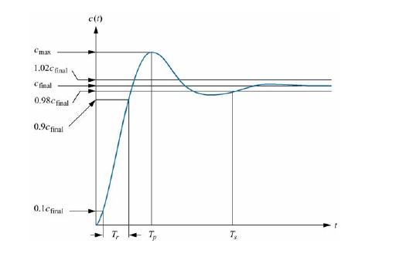
Introduction
Transient
Steady-state

Slide 8
Performances of Control Systems
Specifications (time domain)
  Max OS, settling time, rise time, peak time,
Standard input signals used in design
  actual signals unknown
  standard test signals:
    step, ramp, parabola, impulse, etc. sinusoid
      (study freq. response later)
Transient response
Steady-state response
Relate to locations of poles and zeros

Slide 9

First Order System
R(s)
E(s)
C(s)
Test signal is step function, R(s)=1/s

Slide 10
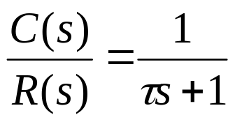
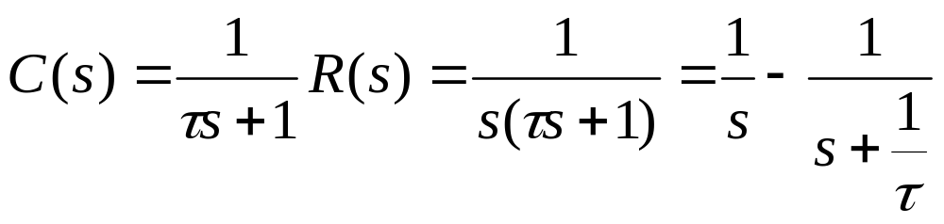
First – order system
A first-order system without zeros can be represented by the following transfer function
Given a step input, i.e., R(s) = 1/s , then the system output (called step response in this case) is

Slide 11
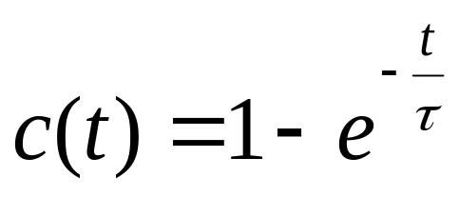


First – order system
Taking inverse Laplace transform, we have the step response
Time Constant:
If t= , So the step response is
C( ) = (1− 0.37) = 0.63
is referred to as the time constant of the response. In other words, the time constant is the time it takes for the step response to rise to 63% of its final value. Because of this, the time constant is used to measure how fast a system can respond. The time constant has a unit of seconds.

Slide 12
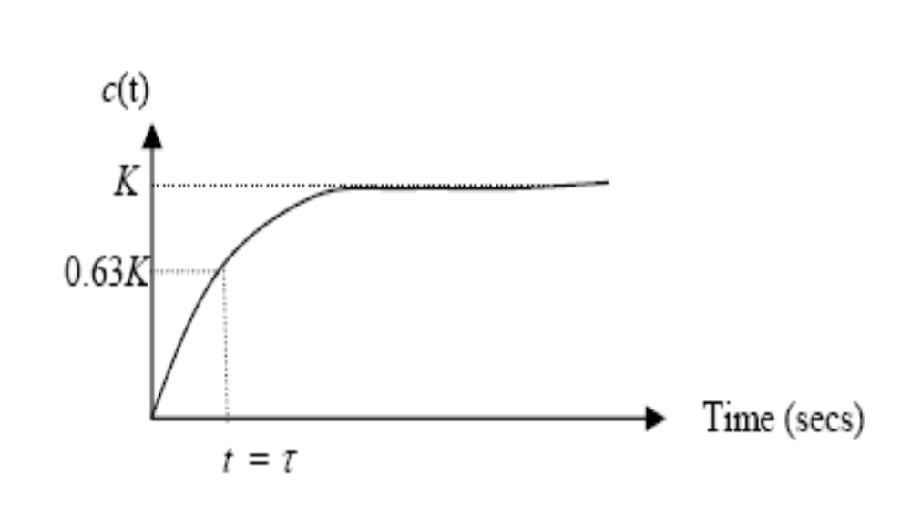
First – order system
Plot c(t) versus time:

Slide 13
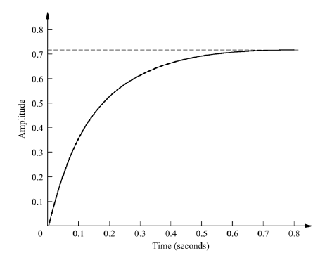
First – order system
Example 1
The following figure gives the measurements of the step response of a first-order system, find the transfer function of the system.

Slide 14
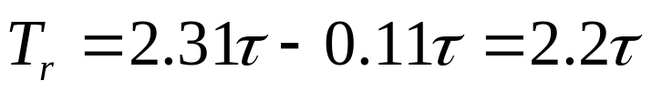
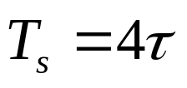
First – order system
Transient Response Analysis
Rise Time Tr:
The rise-time (symbol Tr units s) is defined as the time taken for the step response to go from 10% to 90% of the final value.
Settling Time Ts:
Defined the settling-time (symbol Ts units s) to be the time taken for the step response to come to within 2% of the final value of the step response.

Slide 15
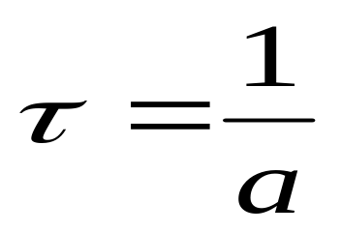
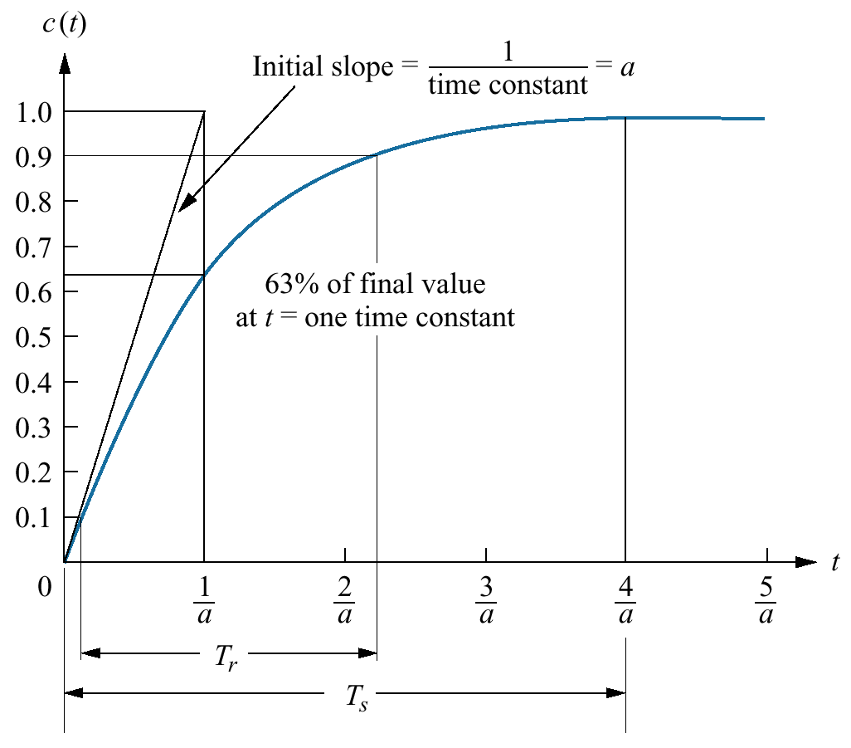
First – order system

Slide 16
Second – Order System
Second-order systems exhibit a wide range of responses which must be analyzed and described.
  Whereas for a first-order system, varying a single parameter changes the speed of response, changes in the parameters of a second order system can change the form of the response.
  For example: a second-order system can display
  characteristics much like a first-order system or, depending on component values, display damped or pure oscillations for its transient response.

Slide 17
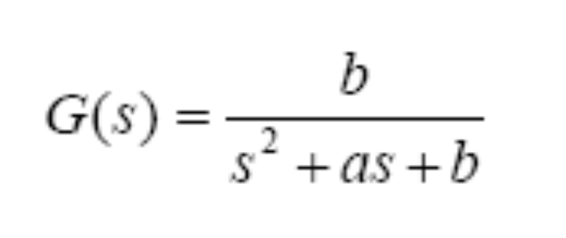
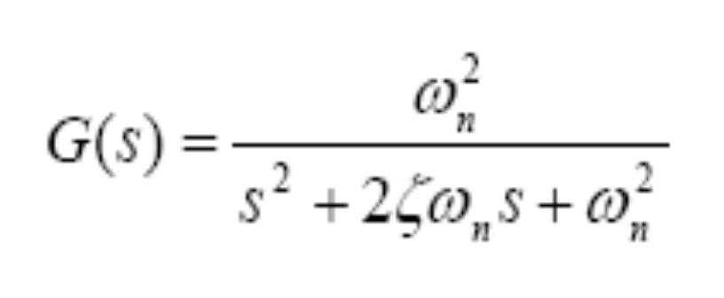
Second – Order System
- A general second-order system is characterized by the following transfer function:
- We can re-write the above transfer function in the following form (closed loop transfer function):

Slide 18
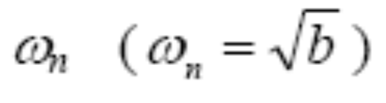

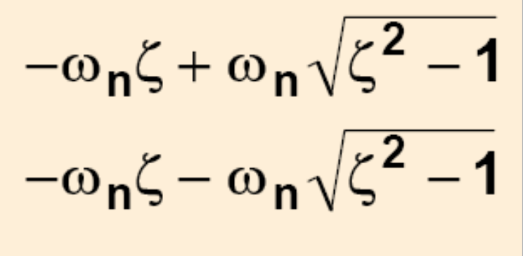
Second – Order System
- referred to as the un-damped natural frequency of the second order system, which is the frequency of oscillation of the system without damping.
- referred to as the damping ratio of the second order system, which is a measure of the degree of resistance to change in the system output.
Poles;
Poles are complex if ζ< 1!

Slide 19
Second – Order System
- According the value of ζ, a second-order system can be set into one of the four categories:
1. Overdamped - when the system has two real distinct poles (ζ >1).
2. Underdamped - when the system has two complex conjugate poles (0 <ζ <1)
3. Undamped - when the system has two imaginary poles (ζ = 0).
4. Critically damped - when the system has two real but equal poles (ζ = 1).

Slide 20
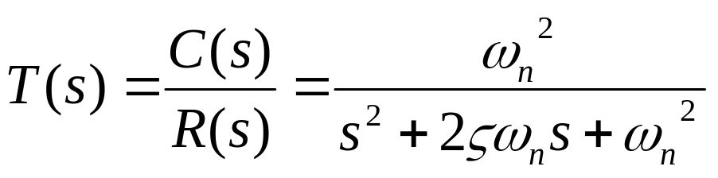
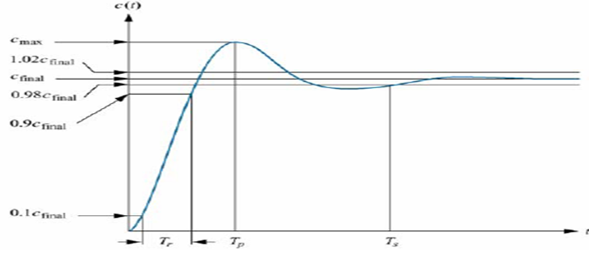
Time-Domain Specification
Given that the closed loop TF
The system (2nd order system) is parameterized by ς and ω_{n}
For 0< ς <1 and ω_{n} > 0, we like to investigate its response due to a unit step input
Two types of responses that are of interest:
Transient response
Steady state response
Transient
Steady State

Slide 21
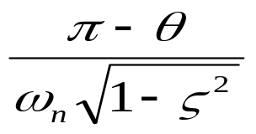
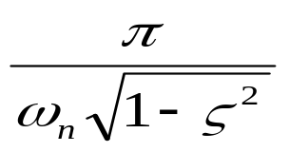
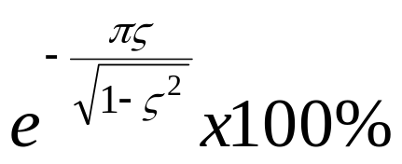
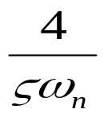
(A) For transient response, we have 4 specifications:
(a) T_{r} – rise time =
(b) T_{p} – peak time =
(c) %MP – percentage maximum overshoot =
(d) T_{s} – settling time (2% error) =
(B) Steady State Response
(a) Steady State error

Slide 22
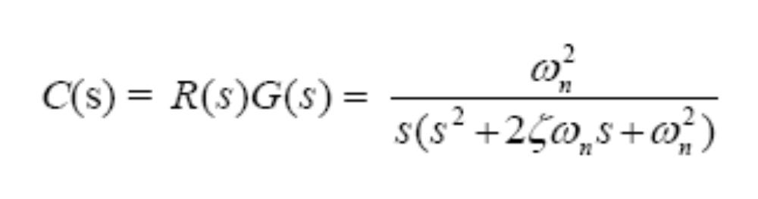



Question : How are the performance related to ς and ω_{n} ?
- Given a step input, i.e., R(s) =1/s, then the system output (or step response) is;
- Taking inverse Laplace transform, we have the step response;
Where;
or

Slide 23
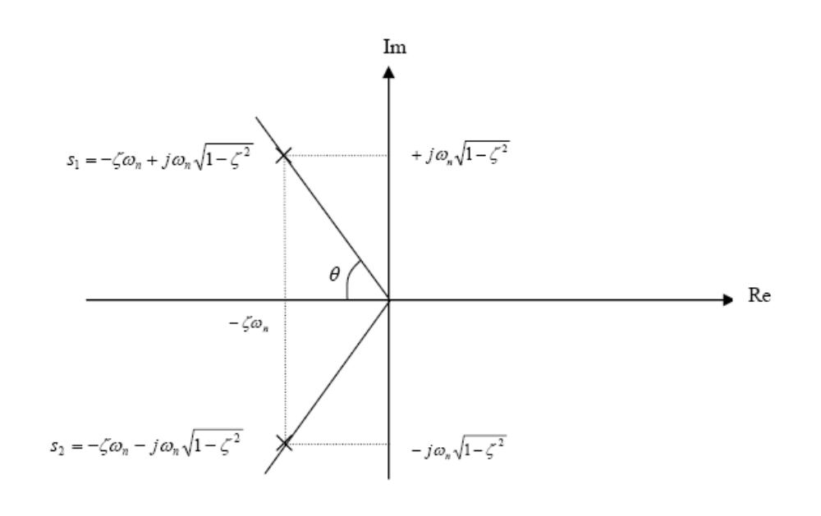
Second – Order System
Mapping the poles into s-plane

Slide 24

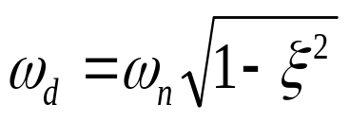

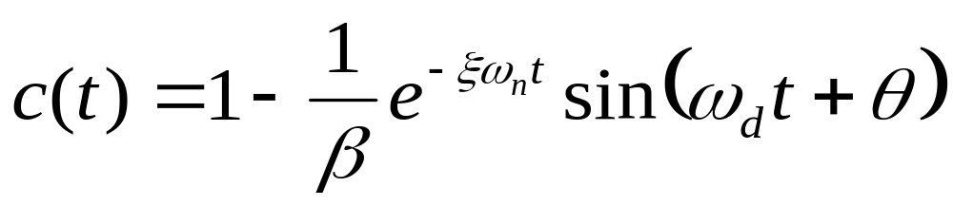
Lets re-write the equation for c(t):
Let:
and
Damped natural frequency
Thus:
where

Slide 25
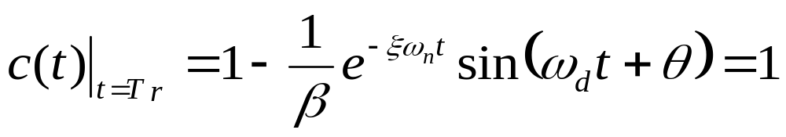


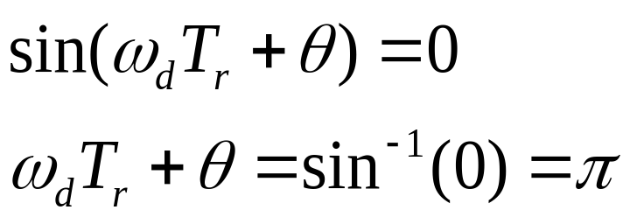
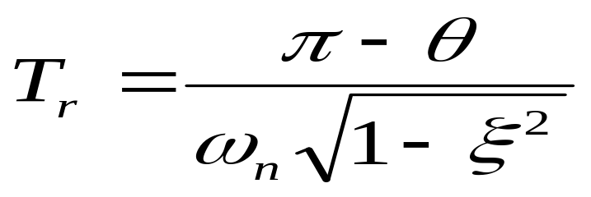
Transient Response Analysis
1) Rise time, Tr. Time the response takes to rise from 0 to 100%

Slide 26
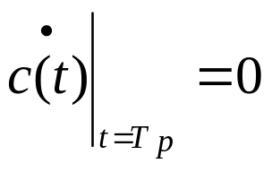
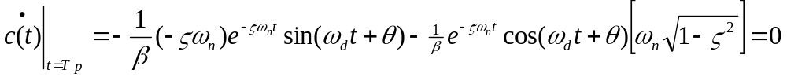
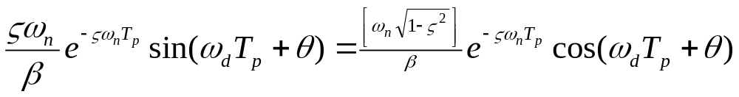
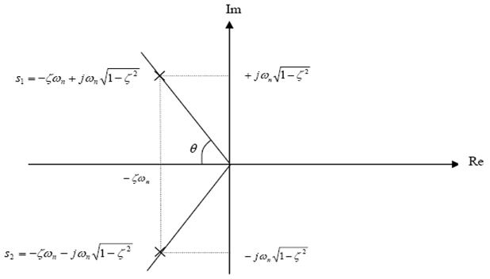
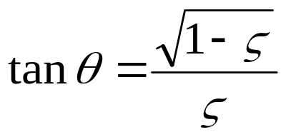
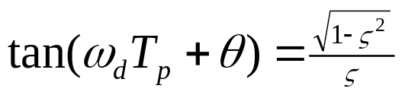
Transient Response Analysis
2) Peak time, Tp - The peak time is the time required for the response to reach the first peak, which is given by;

Slide 27


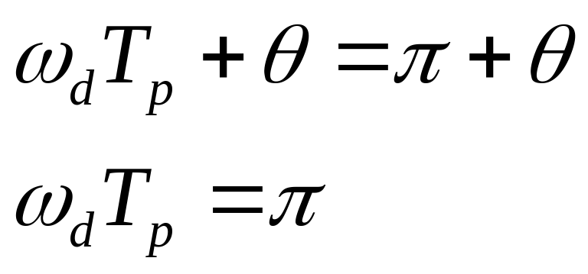
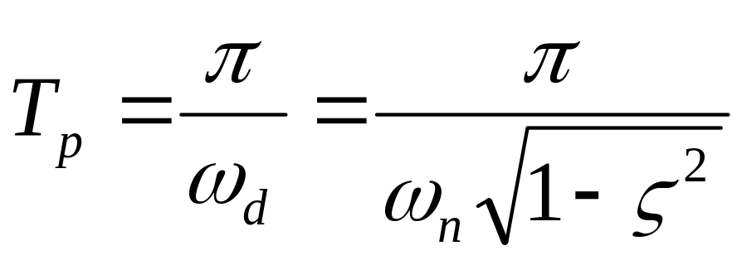
We know that
So,
From this expression:

Slide 28
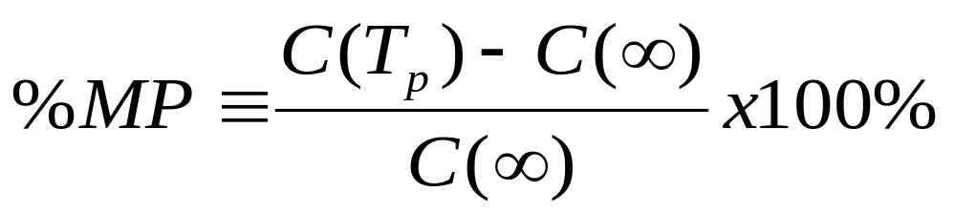
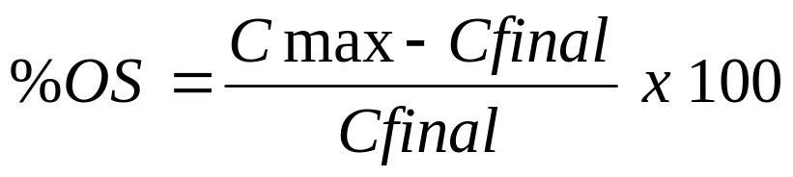
Transient Response Analysis
3) Percent overshoot, %OS - The percent overshoot is defined as the amount that the waveform at the peak time overshoots the steady-state value, which is expressed as a percentage of the steady-state value.
OR

Slide 29
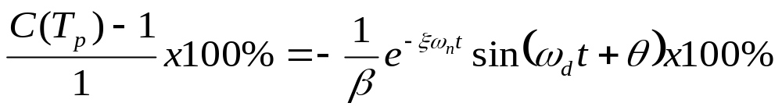
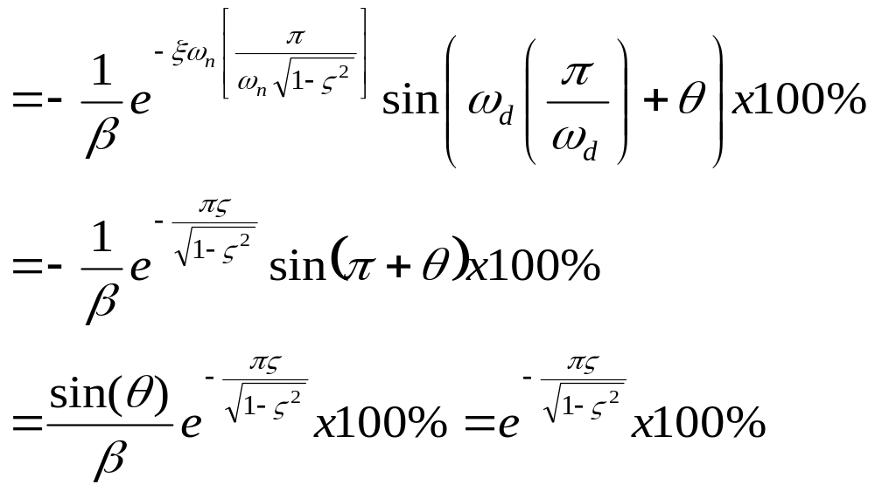
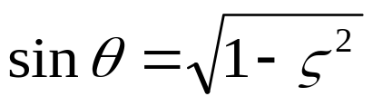
From slide 24

Slide 30
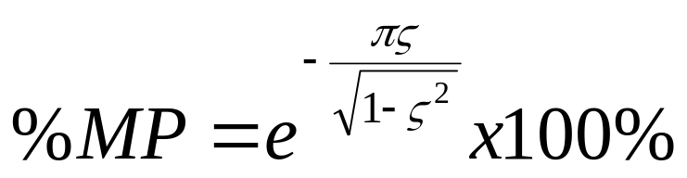
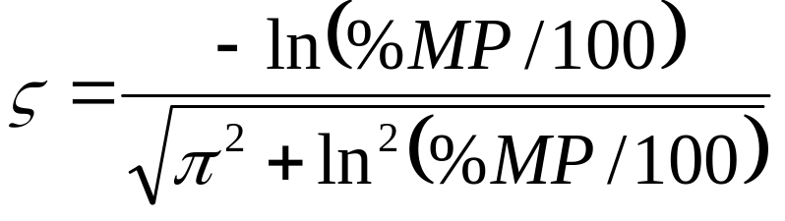
Therefore,
- For given %OS, the damping ratio can be solved from the above equation;

Slide 31
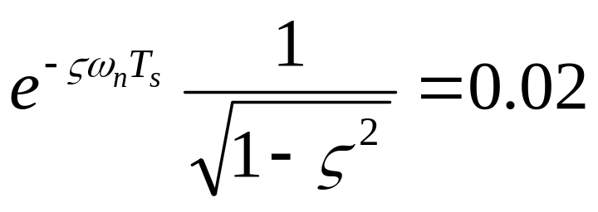
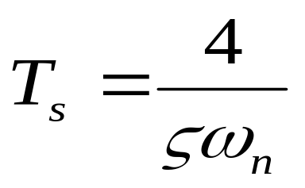
Transient Response Analysis
4) Setting time, Ts - The settling time is the time required for the amplitude of the sinusoid to decay to 2% of the steady-state value.
To find T_{s}, we must find the time for which c(t) reaches & stays within +2% of the steady state value, c_{final.} The settling time is the time it takes for the amplitude of the decaying sinusoid in c(t) to reach 0.02, or
Thus,

Slide 32
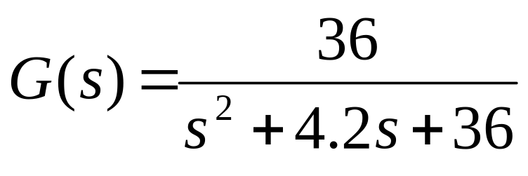
UNDERDAMPED
Example 2: Find the natural frequency and damping ratio for the system with transfer function
Solution:
Compare with general TF
ωn= 6
ξ =0.35

Slide 33
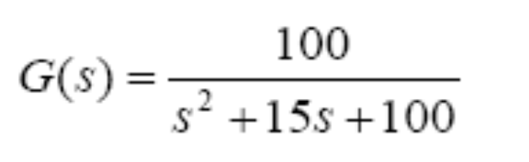
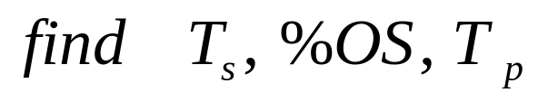
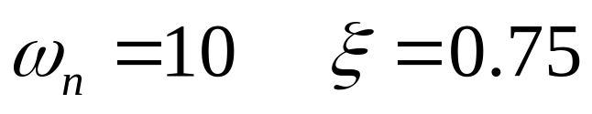
UNDERDAMPED
Example 3: Given the transfer function
Solution:

Slide 34
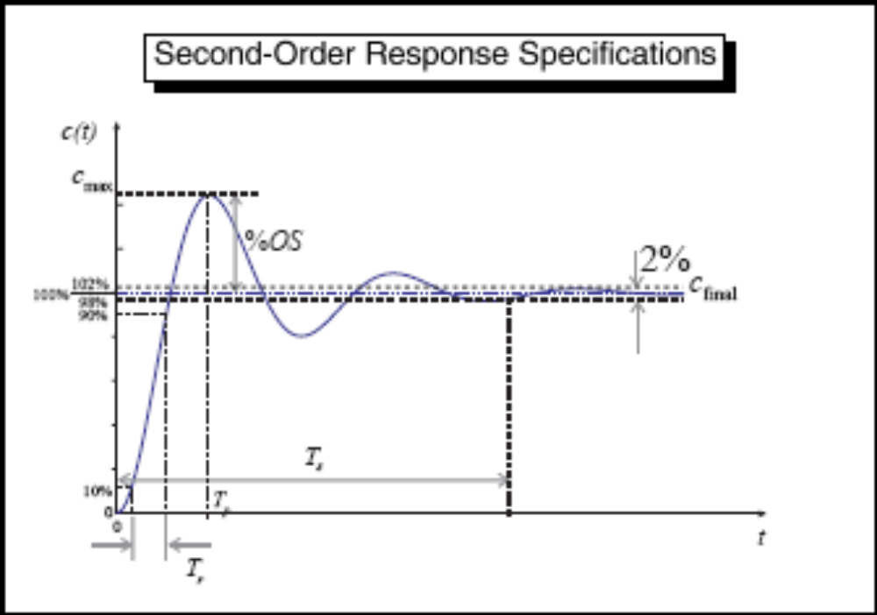
UNDERDAMPED

Slide 35
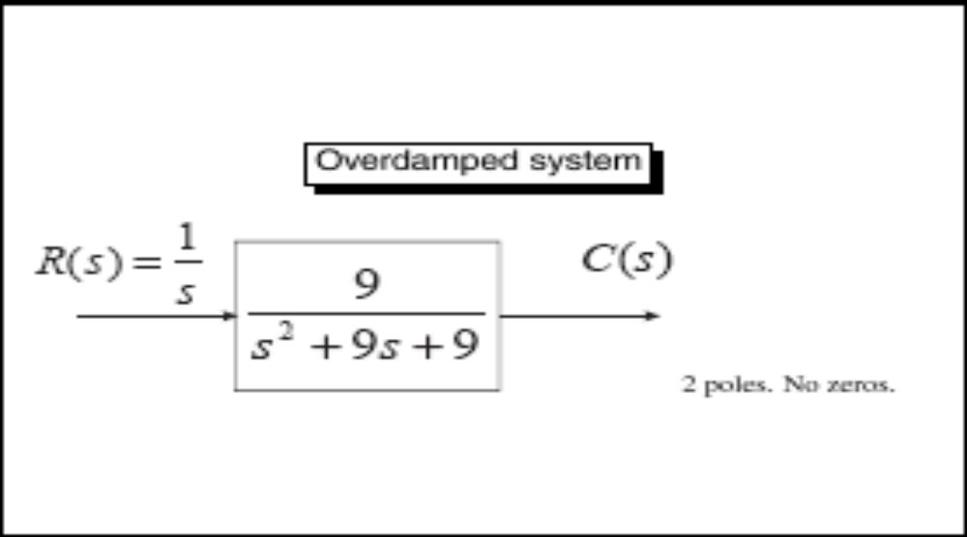


Overdamped Response
a = 9
s= 0; s = -7.854; s = -1.146 ( two real poles)

Slide 36


OVERDAMPED RESPONSE !!!

Slide 37


Underdamped Response
a = 3
s = 0; s = -1.5 ± j2.598 ( two complex poles)

Slide 38

UNDERDAMPED RESPONSE !!!

Slide 39



Undamped Response
a = 0
s = 0; s = ± j3 ( two imaginary poles)

Slide 40

UNDAMPED RESPONSE !!!

Slide 41



Critically Damped System
a = 6
S = 0; s = -3,-3 ( two real and equal poles)

Slide 42

CRITICALLY DAMPED RESPONSE !!!

Slide 43

Second – Order System

Slide 44


Slide 45


Effect of different damping ratio, ξ
Increasing ξ

Slide 46



Second – Order System
Example 4: Describe the nature of the second-order system response via the value of the damping ratio for the systems with transfer function
Do them as your own revision

Slide 47



Slide 48


Slide 49
Points to Remember
Delay time (t_{d})
It is the time required for the response to reach 50% of its final value for the 1st time.
Rise time (t_{r})
It is the time required for the response to rise from 10% and 90% or 0% to 100% of its final value. For under damped system, second order system the 0 to 100% rise time is commonly used. For over damped system, the 10 to 90% rise time is commonly used.
Peak time (t_{p})
It is the time required for the response to reach the 1st of peak of the overshoot.
Maximum over shoot (MP)
It is the maximum peak value of the response curve measured from unity. The amount of max over shoot directly indicates the relative stability of the system.
Settling time (t_{s})
It is the time required for the response to curve to reach & stay with in a range about the final value of size specified by absolute percentage the final value of size specified by absolute percentage of the final value (usually 5% to 2%). The settling time is related to the largest time const., of C.S.

